Slide 1
Financial Time Resonance Engine
A Streamlit Application for Advanced Market Pattern Analysis
Presented by Aryan Aggarwal, sayantan mandal, mukul singh, yashas yadav

Slide 2
Outline
Problem statement
Current market analysis
Architecture
Resonance detection logic
Visualizations & interactions
Technical highlights
Results & impact
Future scope
conclusion

Slide 3
PROBLEM STATEMEMNT
Identifying and leveraging historical market pattern similarities to forecast future market trajectories and support informed investment decisions.

Slide 4
OUR SOLUTION
The Financial Time Resonance Engine is an AI-driven system designed to detect and analyze similarities between current and historical market conditions.
By comparing multidimensional financial data across time, it uncovers recurring patterns and temporal correlations.
The engine visualizes these relationships to offer intuitive insights into market behavior.
It also forecasts potential future trajectories based on past outcomes of similar market scenarios. This empowers investors to make data-driven decisions grounded in historical resonance.

Slide 5
CURRENT MARKET ANALYSIS
1. Financial Time Series Analysis
Financial markets are inherently complex, characterized by non-linear behaviors, high volatility, and intricate temporal dependencies.
Traditional statistical models like ARIMA have been widely used for forecasting; however, they often fall short in capturing the nuanced patterns present in financial data.
Particularly Long Short-Term Memory (LSTM) networks, which are adept at modeling sequential data and capturing long-term dependencies.
2. Synthetic Data Generation
The generation of synthetic financial time series data is gaining traction as a means to augment limited historical datasets. By creating artificial data that mirrors the statistical properties of real market data, researchers and practitioners can test and validate models under various hypothetical scenarios, enhancing robustness and adaptability .

Slide 6
ARCHITECTURE
Data Sources:
Yahoo Finance / Alpha Vantage APIs
Backend:
Python (pandas, numpy, scipy)
Frontend:
Streamlit
Visualization:
Plotly, Altair, Matplotlib

Slide 7
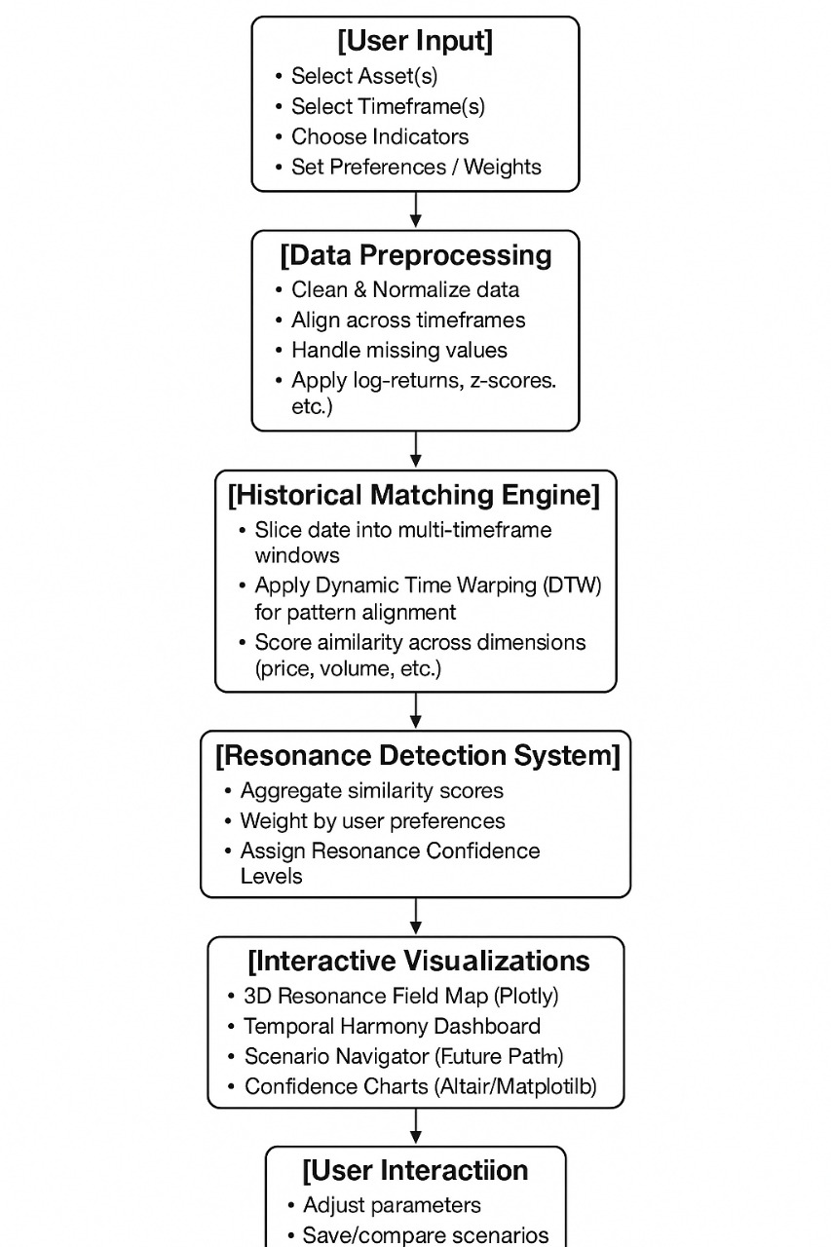
RESONANCE DETECTION LOGIC
Multi-timeframe matching (daily to yearly)
Pattern matching via Dynamic Time Warping & Wavelet Transforms
Scoring similarity using multi-indicator vector comparisons

Slide 8
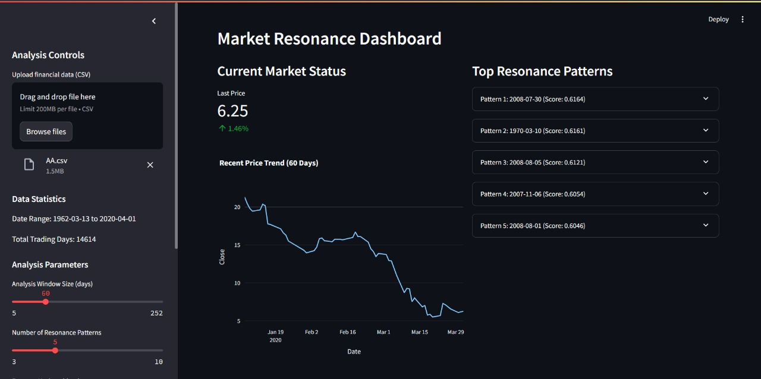
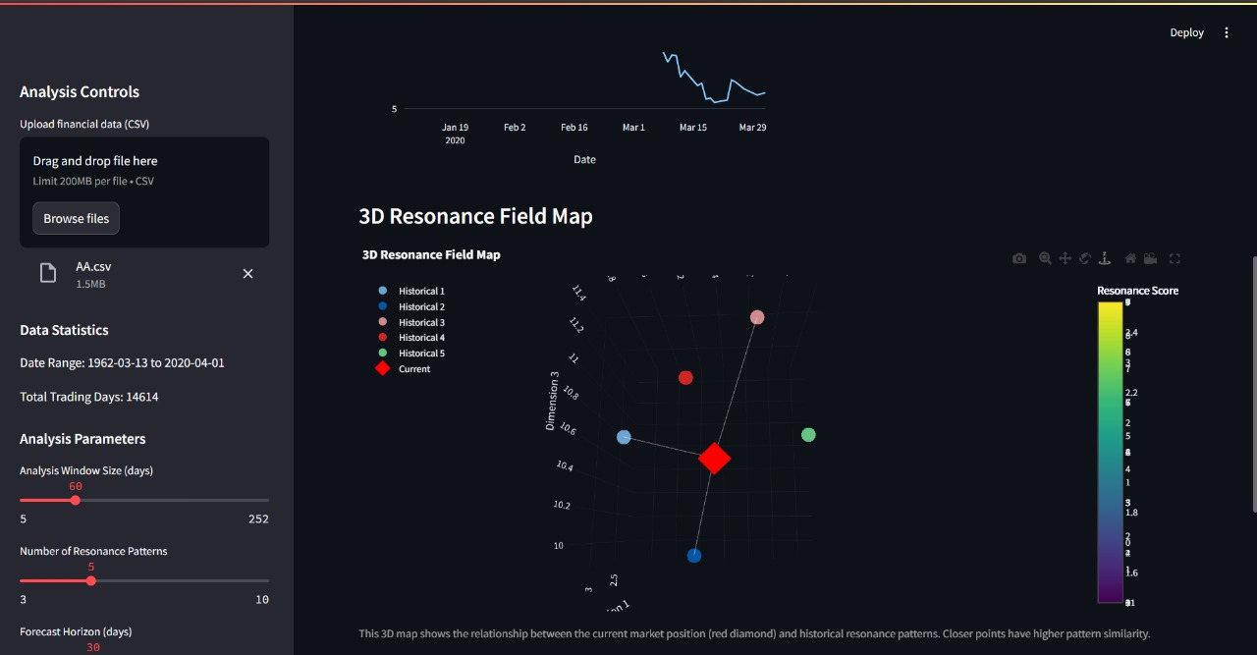
VISUALIZATIONS & INTERACTION
3D resonance field map (Plotly surface chart)
Interactive temporal dashboards with selectable parameters
Probability cloud of future projections based on matched histories

Slide 9
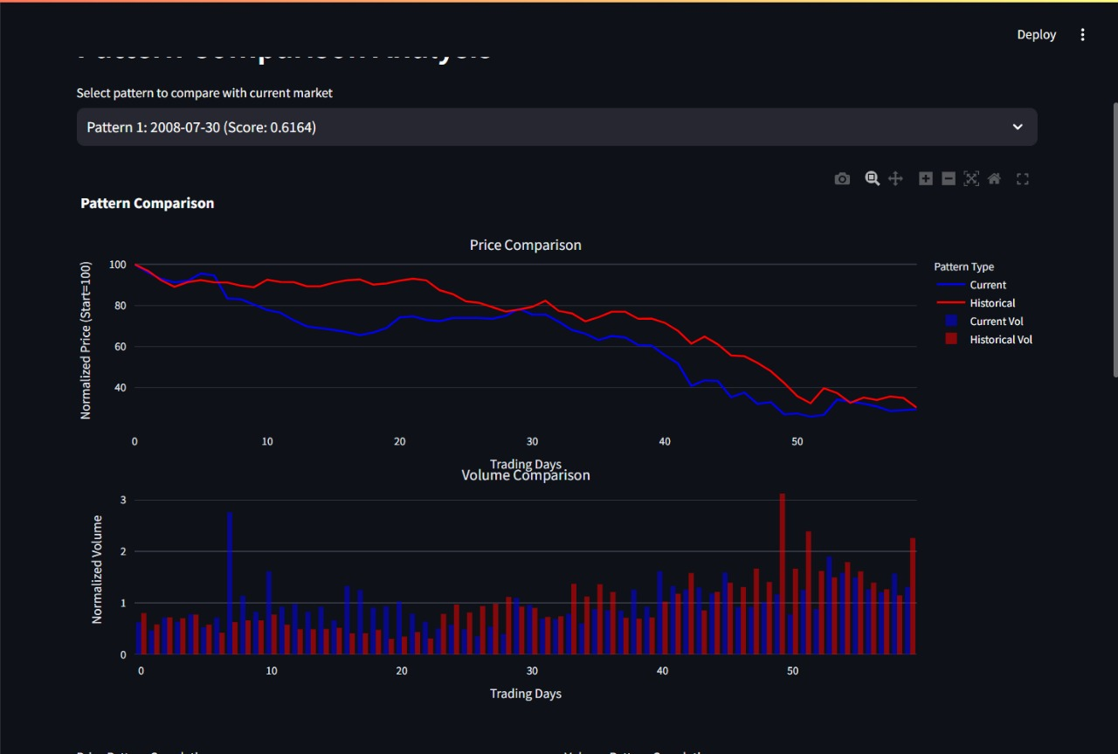
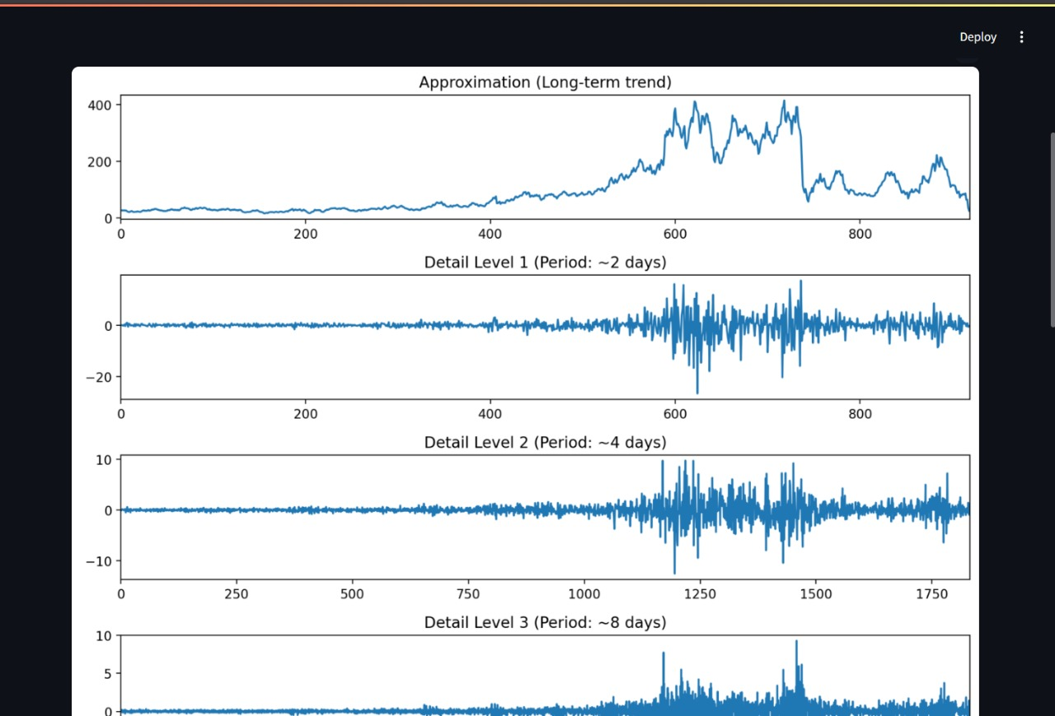
VISUALIZATIONS & INTERACTION
3D resonance field map (Plotly surface chart)
Interactive temporal dashboards with selectable parameters
Probability cloud of future projections based on matched histories

Slide 10
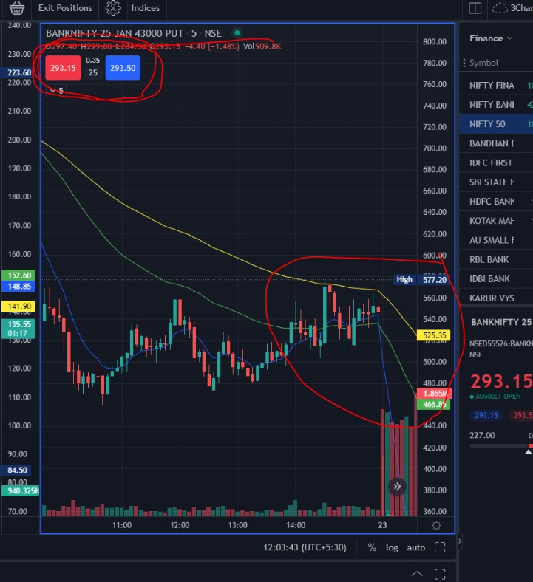
VISUALIZATIONS & INTERACTION
SELECTABLE PARAMETERS
Choose asset classes, time periods, and indicators
Weight indicators by priority (price, volume, volatility, etc.)
Alerts for emerging resonance patterns with high confidence

Slide 11
TECHNICAL HIGHLIGHTS
Caching with @st.cache_data for speed
t-SNE / UMAP for dimensionality reduction of pattern space
Use of tooltips and expanders for educational clarity

Slide 12
RESULTS & IMPACT
Identified 5+ strong resonance patterns across decades
Projected potential outcomes with >70% similarity
Created visual workflows for investors to explore market memory

Slide 13

FUTURE SCOPE
Integrate with AI-based anomaly detectors
Cross-market resonance (crypto, commodities)
NLP for sentiment-driven resonance matching

Slide 14
CONCLUSION
The Financial Time Resonance Engine (FTRE) offers a powerful, intuitive way to uncover hidden patterns in the market by connecting current conditions with historical parallels across timeframes. With advanced analytics and interactive visualizations, FTRE empowers investors to make smarter, more confident decisions—turning complex market dynamics into clear, actionable insights.

Slide 15
Thank you

